Slide 1
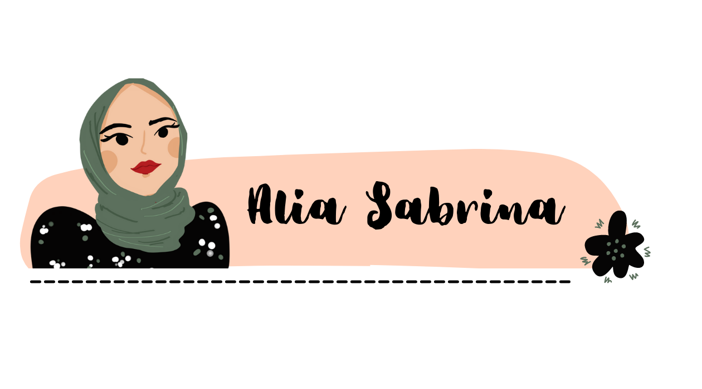

About Me
Education
Family
5 Princesses
Hobby
Interest
Gallery
Facts

Slide 2
About Me
Education
Family
5 Princesses
Hobby
Interest
Gallery
Facts

Slide 3
About Me
Education
Family
5 Princesses
Hobby
Interest
Gallery
Facts

Slide 4
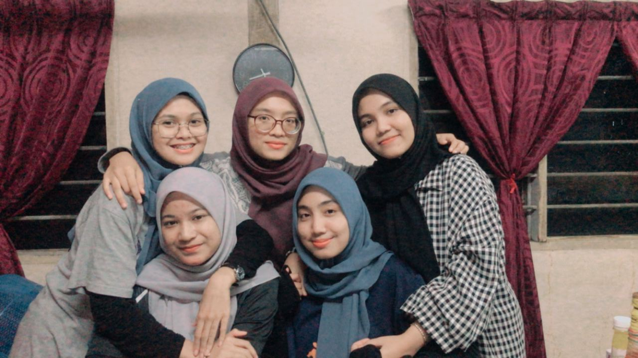
About Me
Education
Family
5 Princesses
Hobby
Interest
Gallery
Facts

Slide 5
About Me
Education
Family
5 Princesses
Hobby
Interest
Gallery
Facts

Slide 6
About Me
Education
Family
5 Princesses
Hobby
Interest
Gallery
Facts

Slide 7
About Me
Education
Family
5 Princesses
Hobby
Interest
Gallery
Facts

Slide 8
About Me
Education
Family
5 Princesses
Hobby
Interest
Gallery
Facts

